Slide 1
RF Direction Detection Team 2
Sylvie Sorese, Ryan Clayton, & Dalton Mitchum

Slide 2
Agenda
Sprint 2 Overview
Progress
Sprint 3 Preview

Slide 3
Sprint 2 Overview
SRS and SDS Refined
Antenna Array Built
Switching Design
GNU Radio Research

Slide 4
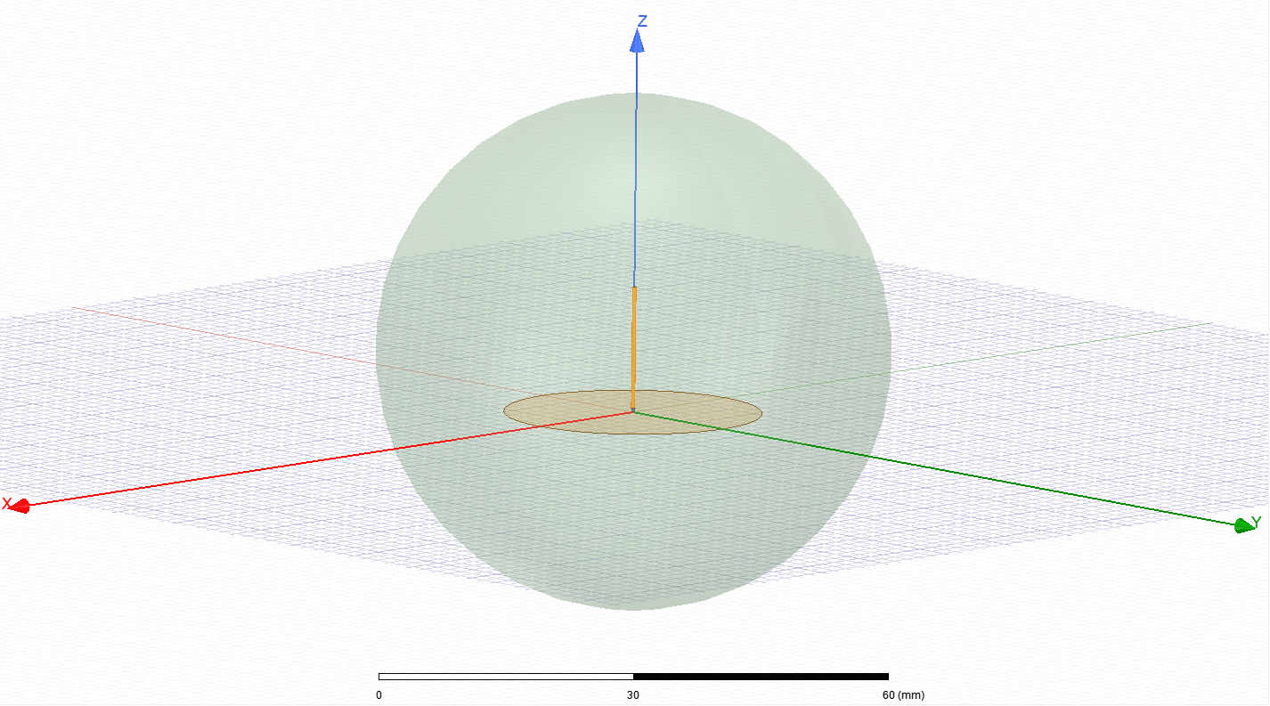
Model of Single 5G Antenna (Without Cornering)

Slide 5
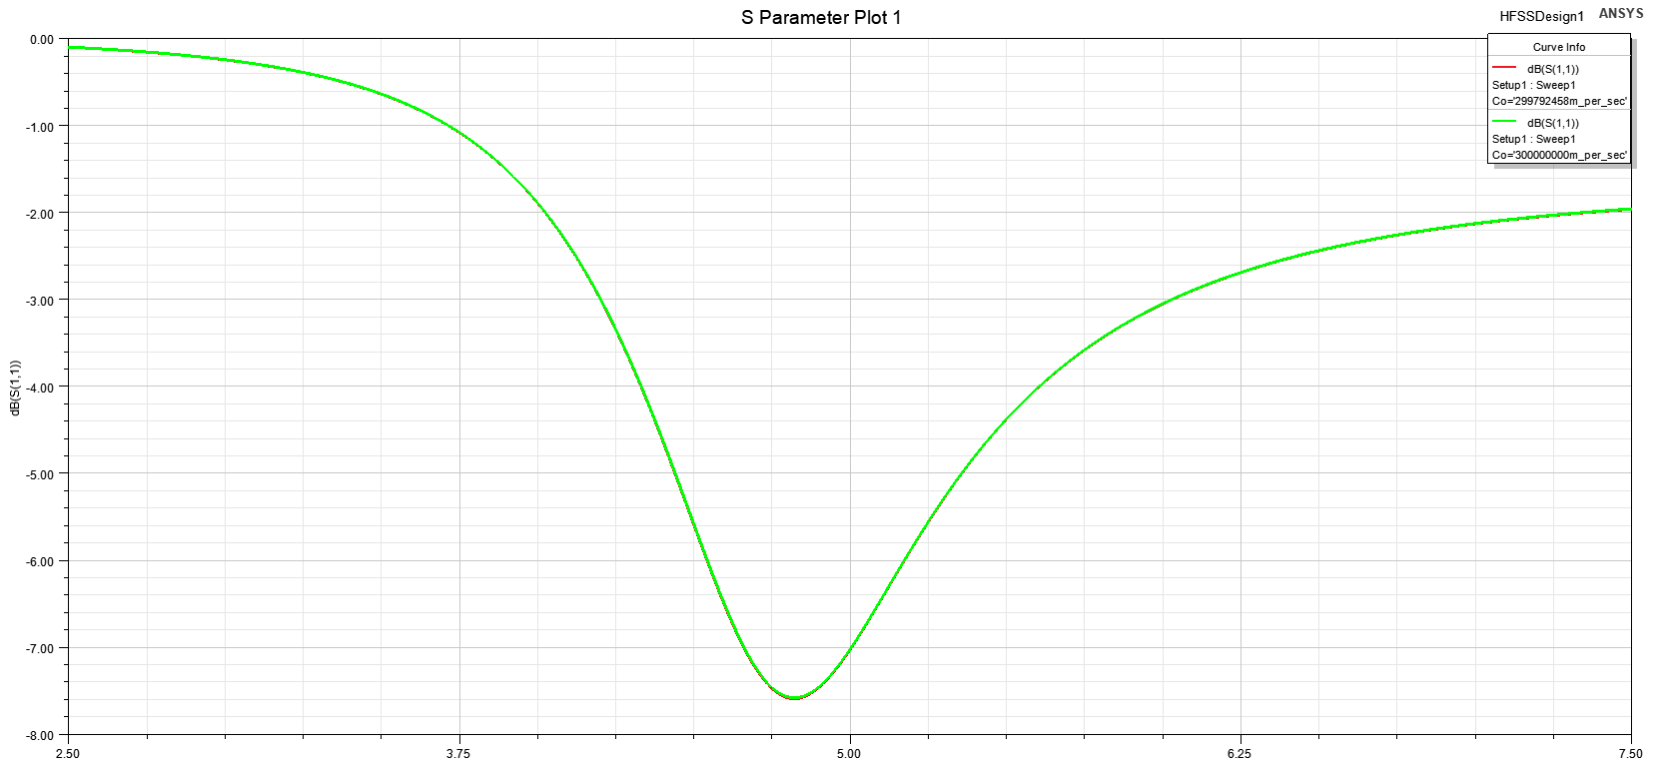
2.5 - 7.5 GHz Sweep of 5G Antenna Model (Without Cornering)

Slide 6
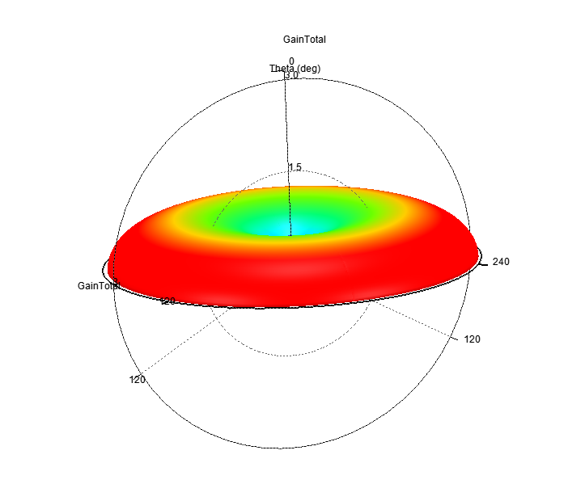
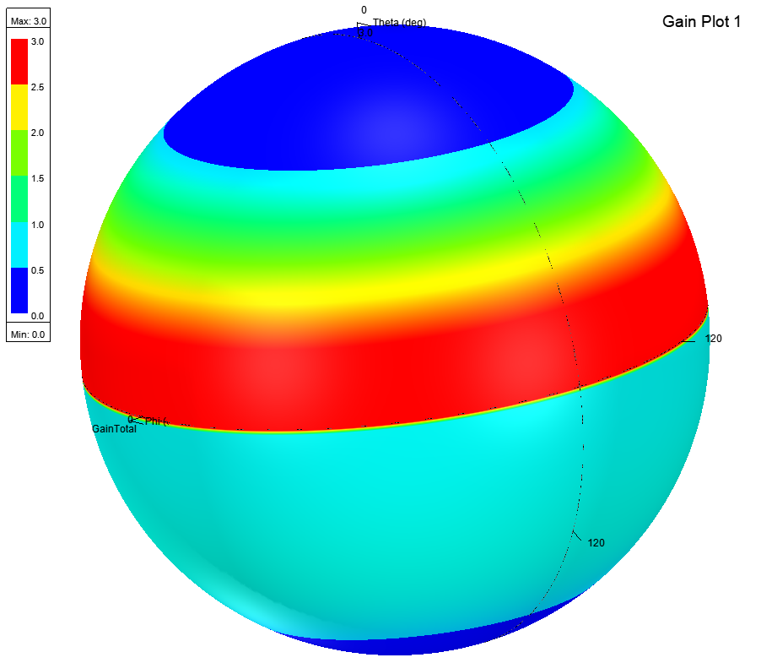
3-D Spherical Gain Plot of 5G Antenna (without cornering)

Slide 7
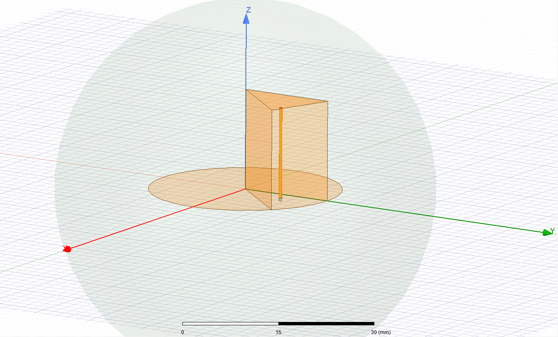
Model of Single 5G Antenna (Cornered)

Slide 8
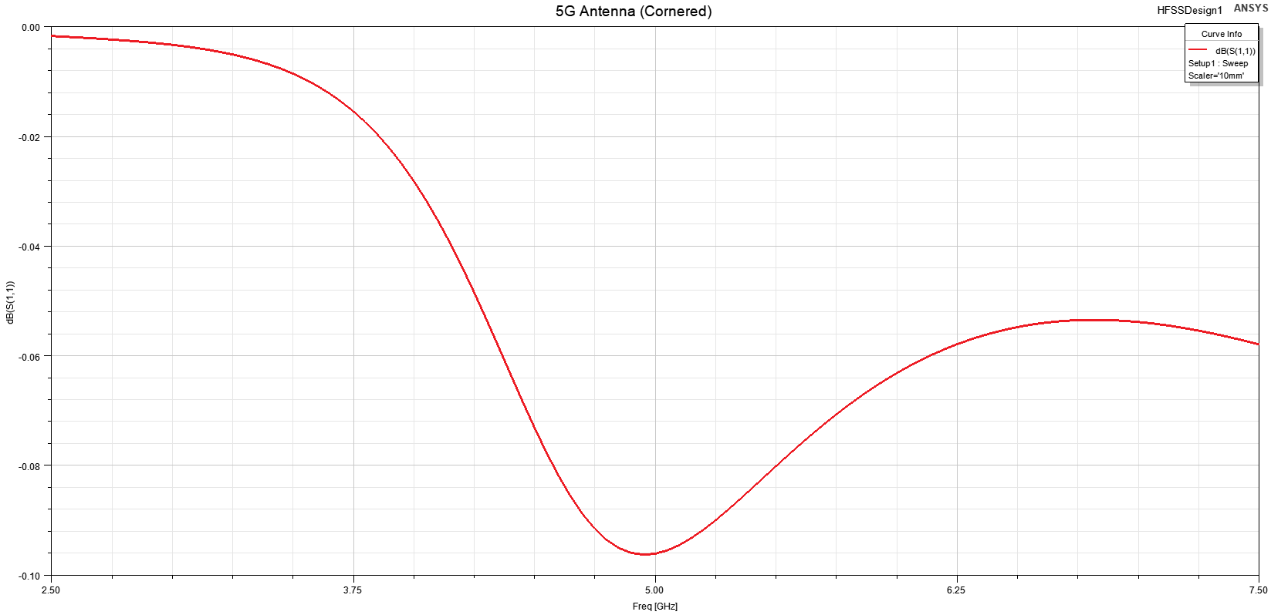
2.5 - 7.5 GHz Sweep of 5G Antenna Model (Cornered)

Slide 9
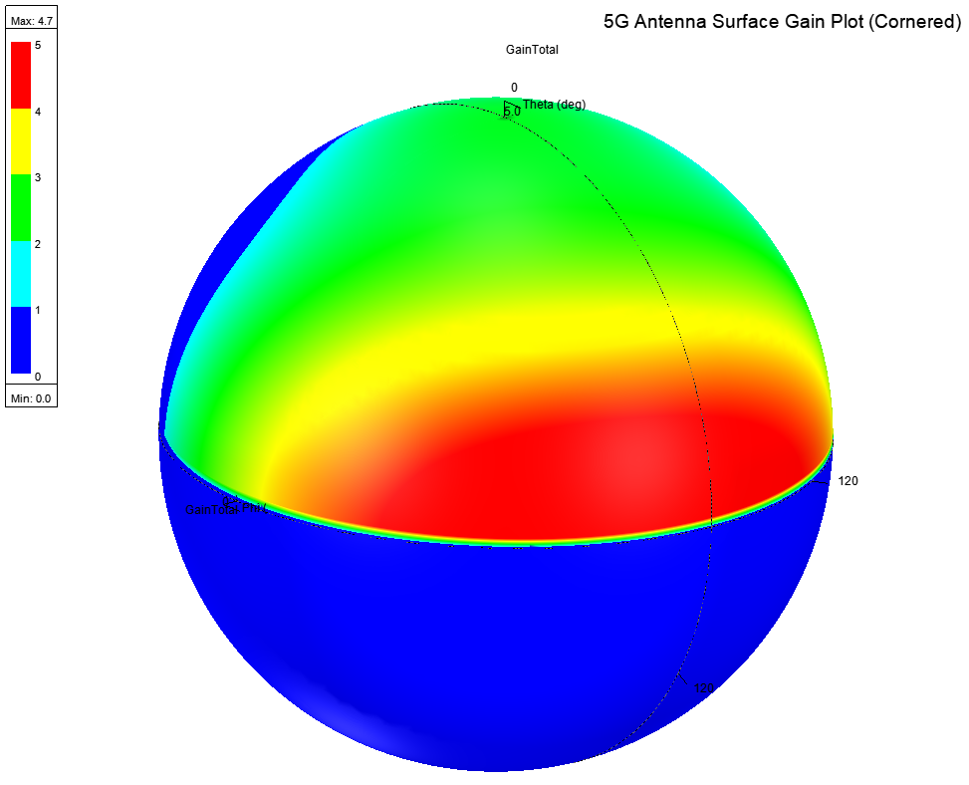
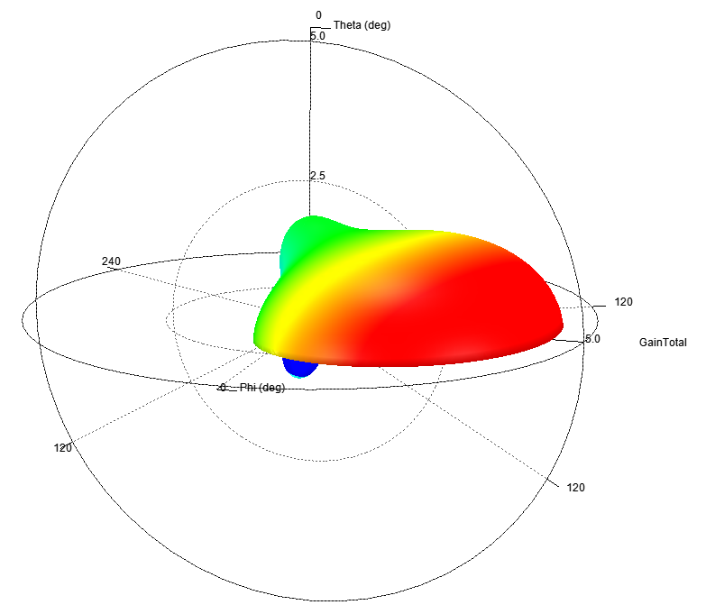
3-D Spherical Gain Plot of 5G Antenna (cornered)

Slide 10
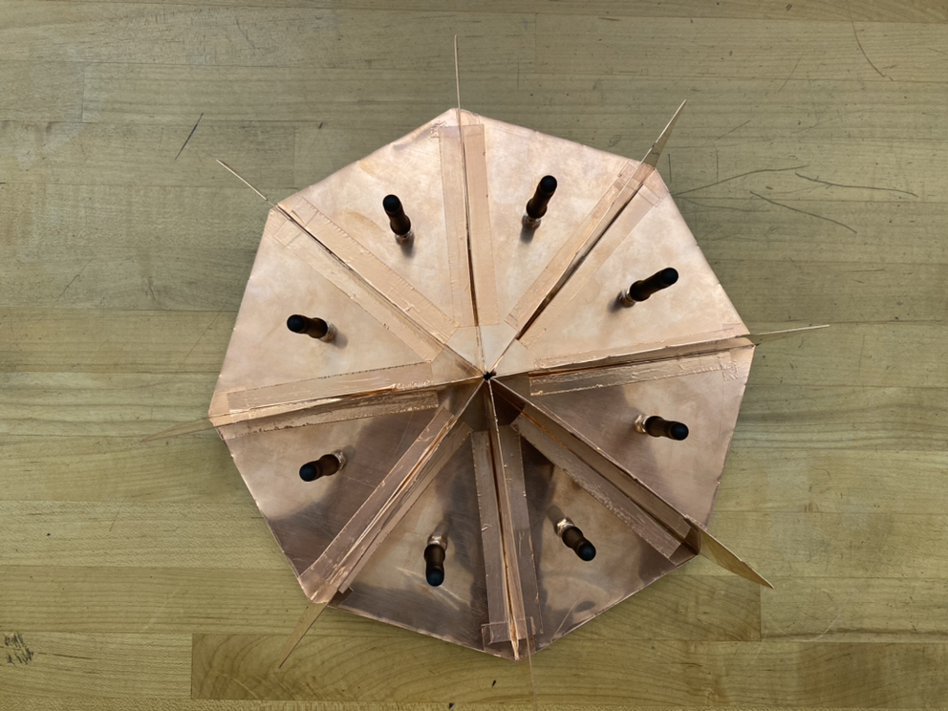
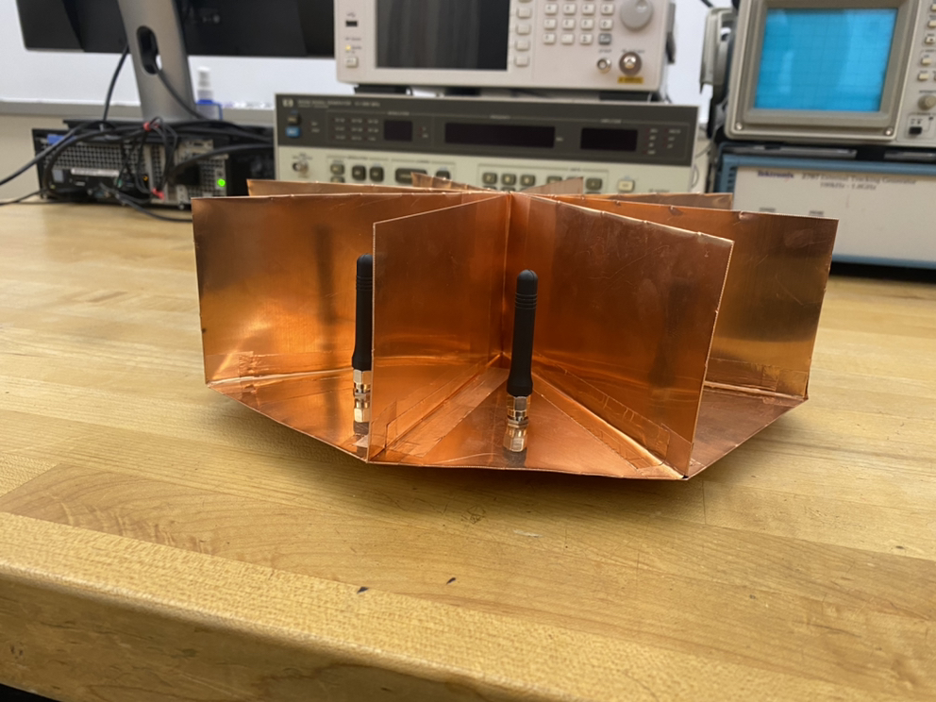
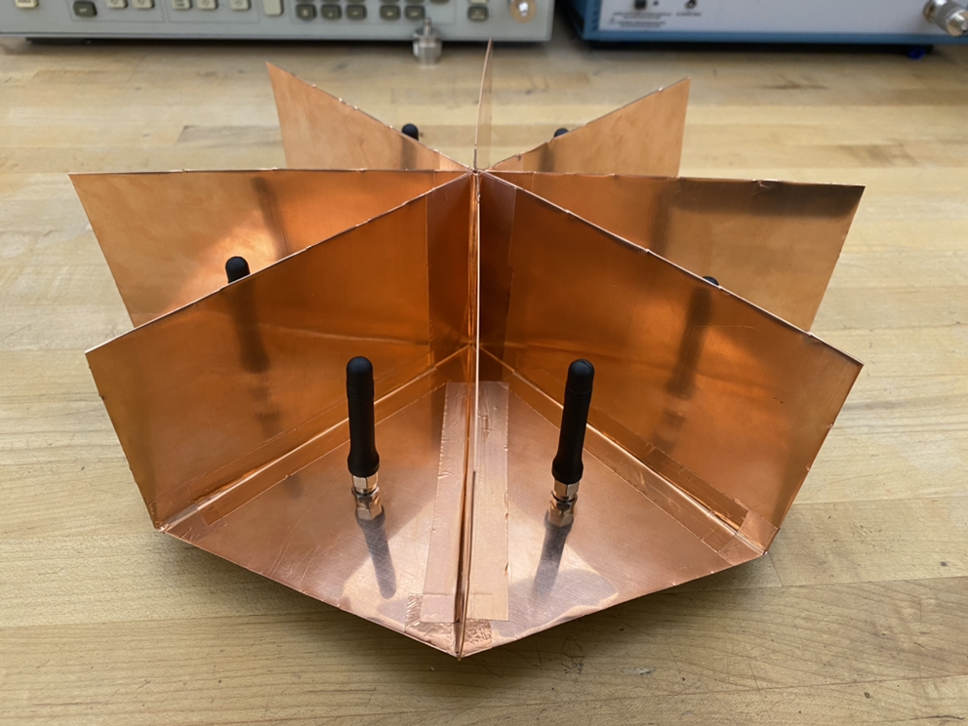
S-Parameters
S(1,1) = -42 dB
S(2,1) = -54 dB
S(3,1) = -65 dB
S(4,1) = -73 dB
S(5,1) = -66 db

Slide 11
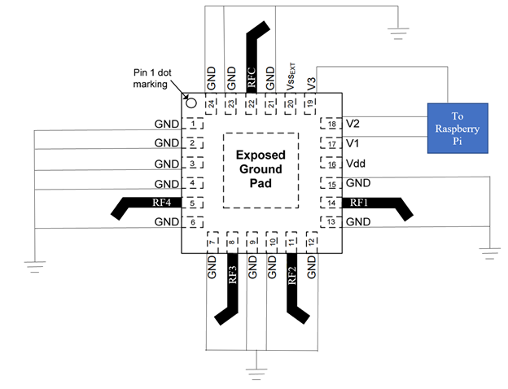
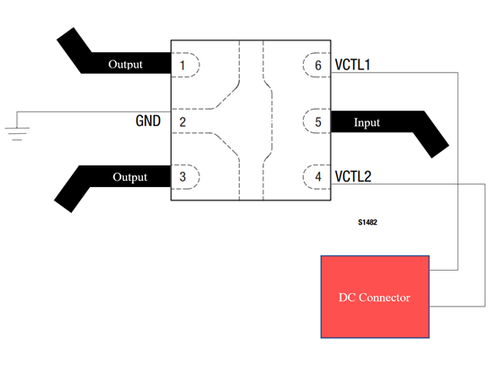
Progress
SPDT Switch PCB Diagram
SP4T Switch PCB Diagram

Slide 12
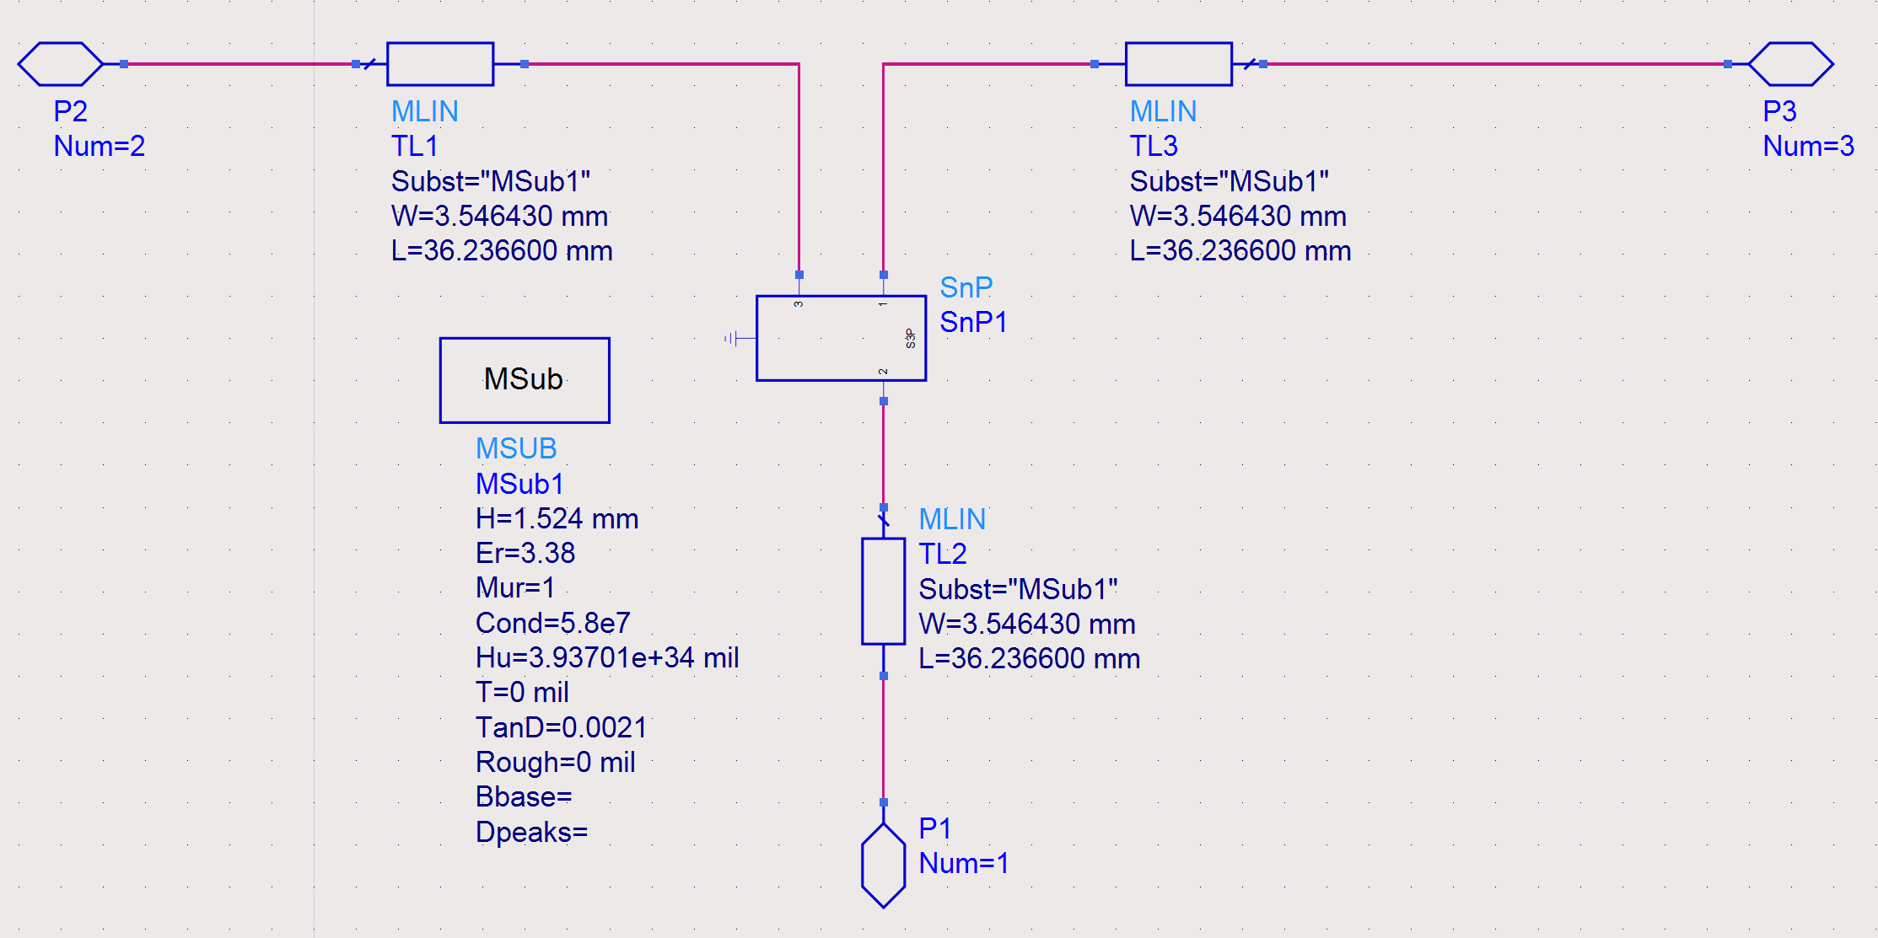
Progress
SPDT Switch PCB Design on ADS

Slide 13
Sprint 3 Preview
Put antenna in the chamber and get a plot of all 8 antennas
Finish PCB board designs
Print PCB boards
Assemble code for GNU Radio Application
Assemble system and successfully receive signal

